Slide 1
CMPT 370 Intermediate Software Engineering

Slide 2
JUnit
A Test Suite
Developed by Beck and Gamma
Provides tools to test the Java code

Slide 3
Structure
TestRunner
TestCase
Assert

Slide 4
Steps in JUnit Testing
Get and import JUnit
Make a Test Class
Write Testing Code
Annotate Your Code
Run it

Slide 5
Steps in JUnit Testing
Public class TestMyClass extends TestClass
{
public void testmyMethod() {…}
}
Public class TestMyClass extends TestClass
{
public void testMyMethod() {assertEqual(…); assertTrue(…)}
}
Public class MyClass
{
public void myMethod() {…}
}

Slide 6
Obtaining JUnit
Get it from http://Junit.org
It is a jar file, ready to be integrated in any java system.
Download and import in Eclipse or Netbeans or any other IDE you use.

Slide 7
Making Test Class
You need to extend the abstract class TestCase.
Name of the extended class must be TestClassName or ClassNameTest for being a test class of the class ClassName.
Naming is Strict.

Slide 8
Writing Testing Methods
Inside the test class, you must declare one method for testing each method of the class being tested.
Method names are strict.
Test methods have to follow this signature
public void testMethodName() where methodName() is the name of the method you are testing.
Include a setUp() and tearDown() method as constructor and destructor.

Slide 9
Our Class
public class Counter
{
private int value;
public Counter() {value = 0;}
public int increment() {value++;}
public int decrement(){value--;}
public getValue(){return value;}
}

Slide 10
Our TestClass
public class CounterTest extends junit.framework.TestCase { Counter counter1; public CounterTest() { } // default constructor
protected void setUp() { // creates a (simple) test fixture counter1 = new Counter(); }
public void testIncrement() { assertTrue(counter1.increment() == 1); assertTrue(counter1.increment() == 2); }
public void testDecrement() { assertTrue(counter1.decrement() == -1); } }

Slide 11
Asserts
These are statements that checks your code.
General Structure
Message
Expected value
Actual value

Slide 12
assertTrue(String message, Boolean test)
Checks whether the test yields a true result or not.
Passes
If the test is goes into a true result.
Fails
If the test goes into a false result.

Slide 13
assertFalse(String message, Boolean test)
Just the opposite of assertTrue();
Passes
If the test is goes into a false result.
Fails
If the test goes into a true result.

Slide 14
assertNull(String message, Object object)
Checks for a null reference.
Passes
If the object is a NULL
Fails
If it is not a NULL reference.

Slide 15
assertNotNull(String message, Object object)
Checks for an existing object.
Passes
If the object is a existing.
Fails
If it is not existing.

Slide 16
assertEquals(String message, Object expected, Object actual)
Checks whether an expected value is attained
Requires a proper equals() method
Passes
If the actual object is the same as the expected object.
Fails
If the actual object differs with the expected object.

Slide 17
assertSame(String message, Object expected, Object actual)
Uses the == method
Passes
If expected == actual.
Fails
If expected != actual.

Slide 18
assertNotSame(String message, Object expected, Object actual)
Uses the == method
Passes
If expected != actual.
Fails
If expected == actual.

Slide 19
Annotations
JUnit accepts predefined annotations as directives.
Annotations control whether to test and when to test.

Slide 20
Annotations
@Test public int method()
This method is a test method.
@Before public int method()
This method will run before each test.
@After public int method()
This method will run after each test.

Slide 21
Annotations
@BeforeClass public int method()
This method will run before any test.
@AfterClass public int method()
This method will run after finishing all tests.
@Ignore public int method()
Ignores it for testing.

Slide 22
Annotations
@Test(expected=exception) public int method()
Tests only if the method throws the exception.
@Test(timeout=n) public int method()
Fails the test if the method takes more than n milliseconds of time.

Slide 23
Parameterized Test
Junit test can take parameters
Use @RunWith(Parameterized.class) annotation

Slide 24
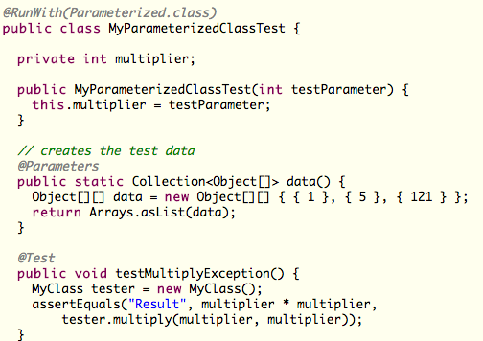
Parameterized Test

Slide 25
Thank You
Questions?

